Slide 1
Python programming basics

Slide 2
Python Fundamentals
In this chapter you'll learn about:
Python – writing it and running it
Basic statements
Numbers, strings and Boolean variables
Keyboard input. Screen output.
Casting

Slide 3
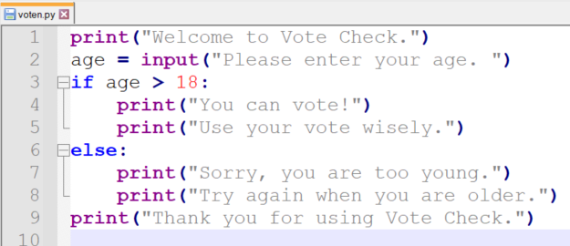
A simple program with 2 errors
Notes:
This is an “in at the deep end” moment. We are getting an early look at some key concepts that we will look into later.
Even if you are entirely inexperienced in programming, what do you think this does, based on English, logic, and the voting system in this country.
If you are an experienced programmer, can you spot the mistake?
Can you spot BOTH mistakes?
Answers:
age is a string; it needs to be an integer. This will be covered in the next slide.
line 3 should be
if age >= 18:

Slide 4
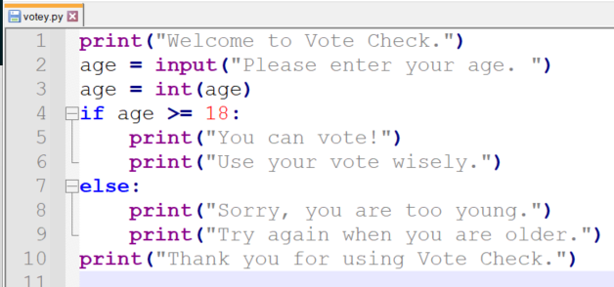
A simple program with no errors (?)
Notes:
Python, like most languages, reads the righthand side of a = sign before assigning the returned value to the variable on the left.
Lines 5 and 6 are indented after the if statement, so they will only be executed if the condition on line 4 is true.
Lines 8 and 9 are indented after the else statement, so they will only be executed if the condition on line 4 is false.
Line 10 is not indented, so it does not depend on the condition on line 4.

Slide 5
Getting Started With Python
For hands-on experience, and to be able to follow along, please open “Getting Started With Python” in the exercise guide folder.
We will work through it together.
Feel free to ask questions!

Slide 6
Comments in code
Comments are explanations to help readers understand your code
Use a # to tell Python to ignore the characters to the right
# process user information
print('Hello World!') # display greetings
# x = x + 3
Notes:
When teaching, comments are often used to explain the code itself, e.g.
x = 5 # Assign the value of 5 to the variable named x
If meaningful names are chosen for variables and functions, the individual lines will often not need comments.
Most comments will then be used to explain what a block of code is doing rather than individual lines.

Slide 7
Data Types in Python
There are three basic variable types
Numbers: Integer and Float
1,2,3, 1.23, 0.0005
Character or String
'Hello world' or "Hello world"
Boolean True or False (case-sensitive)
age=21
salary = 2000.78
companyName='QA Ltd'
isRegistered = True
hasLicence = False
type is determined automatically.
value can change.
Notes:
The best way to learn to code is to actually write the code yourself. You should do your best to follow along, writing code with me during the presentation.
You do need to know the basics of how programs work. They rely on commands and the data that the commands operate on. Data can be literals, i.e. actual numbers or pieces of text, or data can be held in variables.

Slide 8


Variables naming standards
Use letters not punctuations
No 'reserved word'
salay$ = 1500
my-city='London'
my city='London
my_city='London'
myCity='London'
print = 10
Notes:
A Python identifier is a name used to identify a variable, function, class, module or other object (more on functions, classes & modules later). An identifier starts with a letter A to Z or a to z or an underscore (_) followed by zero or more letters, underscores and digits (0 to 9).
Python does not allow punctuation characters such as @, $, and % within identifiers. Like most (but not all) programming languages, Python is case sensitive so Manpower and manpower are two different identifiers in Python.

Slide 9

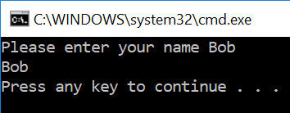
User input using keyboard
Input with a prompt input(<prompt>)
name = input('Please enter your name ')
print(name)

Slide 10

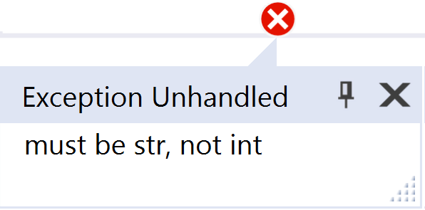
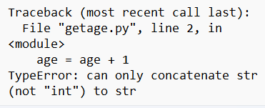
Putting strings together
username = 'Bob'
print('Hello' , username)
print('Hello' + username)
print('Hello ' + username)
Hello Bob
HelloBob
Hello Bob
Cannot add numbers and strings
age = 21
print('Your age is ' + age)
Message = 'Your age is ' + age
keyboard input is always text… even if it 'looks' like a number
age = input('Please enter your age ')
age = age + 1
Notes:
Bottom of slide: Attempting to add a number to a string will result in an error message such as the one on the left with the Visual Studio IDE or the one on the right if running it in the command prompt.

Slide 11
Which type?
>>> w = 42
>>> x = 42.0
>>> y = 'Forty two'
>>> z = True
>>> type(w)
<class 'int’>
>>> type(x)
<class 'float’>
>>> type(y)
<class 'str’>
>>> type(z)
<class 'bool'>
Notes:
We can use the type function to find out the data type of a variable.

Slide 12

Casting
keyboard is text so we use casting to convert it to other types
age = int(input('What is your age? '))
age = age + 1
print('Next year you will be', age ,'years old')
What is your age? 21
Next year you will be 22 years old
age = input('What is your age? ')
age = int(age)
age = age + 1
print('Next year you will be', age ,'years old')
Notes:
The slide shows two methods of casting. The first example is more common.

Slide 13
Casting a number to string
Use the str() function
## Find the average of a few numbers
total = 1 + 3 + 5 + 7 + 9 + 11
average = total / 6
print("Total is = " + str(total))
print("Average is = " + str(average))

Slide 14
Casting floats
price = int(input('What is the price? '))
totalPrice = price * 1.2
price = float(input('What is the price? '))
totalPrice = price * 1.2
Notes:
Integers cannot take part in float operations. Cast to float to perform such operation as seen on the slide.

Slide 15
Lab
In this lab you will write code to:
Edit code in Notepad++
Compile and run your code
Input values into variables
Lab duration: 30 minutes
01-Python Programming basics Lab.docx

Slide 16
Further activity
Join a group.
Building on the voting program, write a program that asks you your age and tells you if you are eligible for an 18-30 holiday.
Begin with one that simply says Yes or No.
Develop it so that it tells you if you are eligible, or too young, or too old.
Note that Python recognises “and” and “or” in its if statements.

Slide 17
Summary
In this chapter you learned about:
Basic statements
Numbers, strings and Boolean variables
Keyboard input. Screen output.
Casting

Slide 18
Further Reading
https://www.python.org/
https://www.python.org/dev/peps/pep-0008/#a-foolish-consistency-is-the-hobgoblin-of-little-minds

